Slide 1

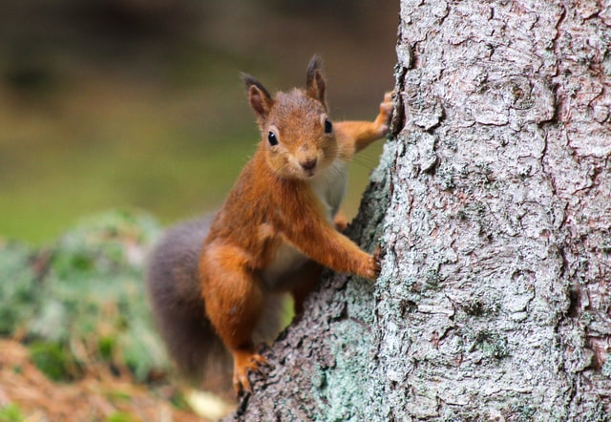
Predicting the Colors of Squirrels in Central Park
By Vanessa Razon

Slide 2
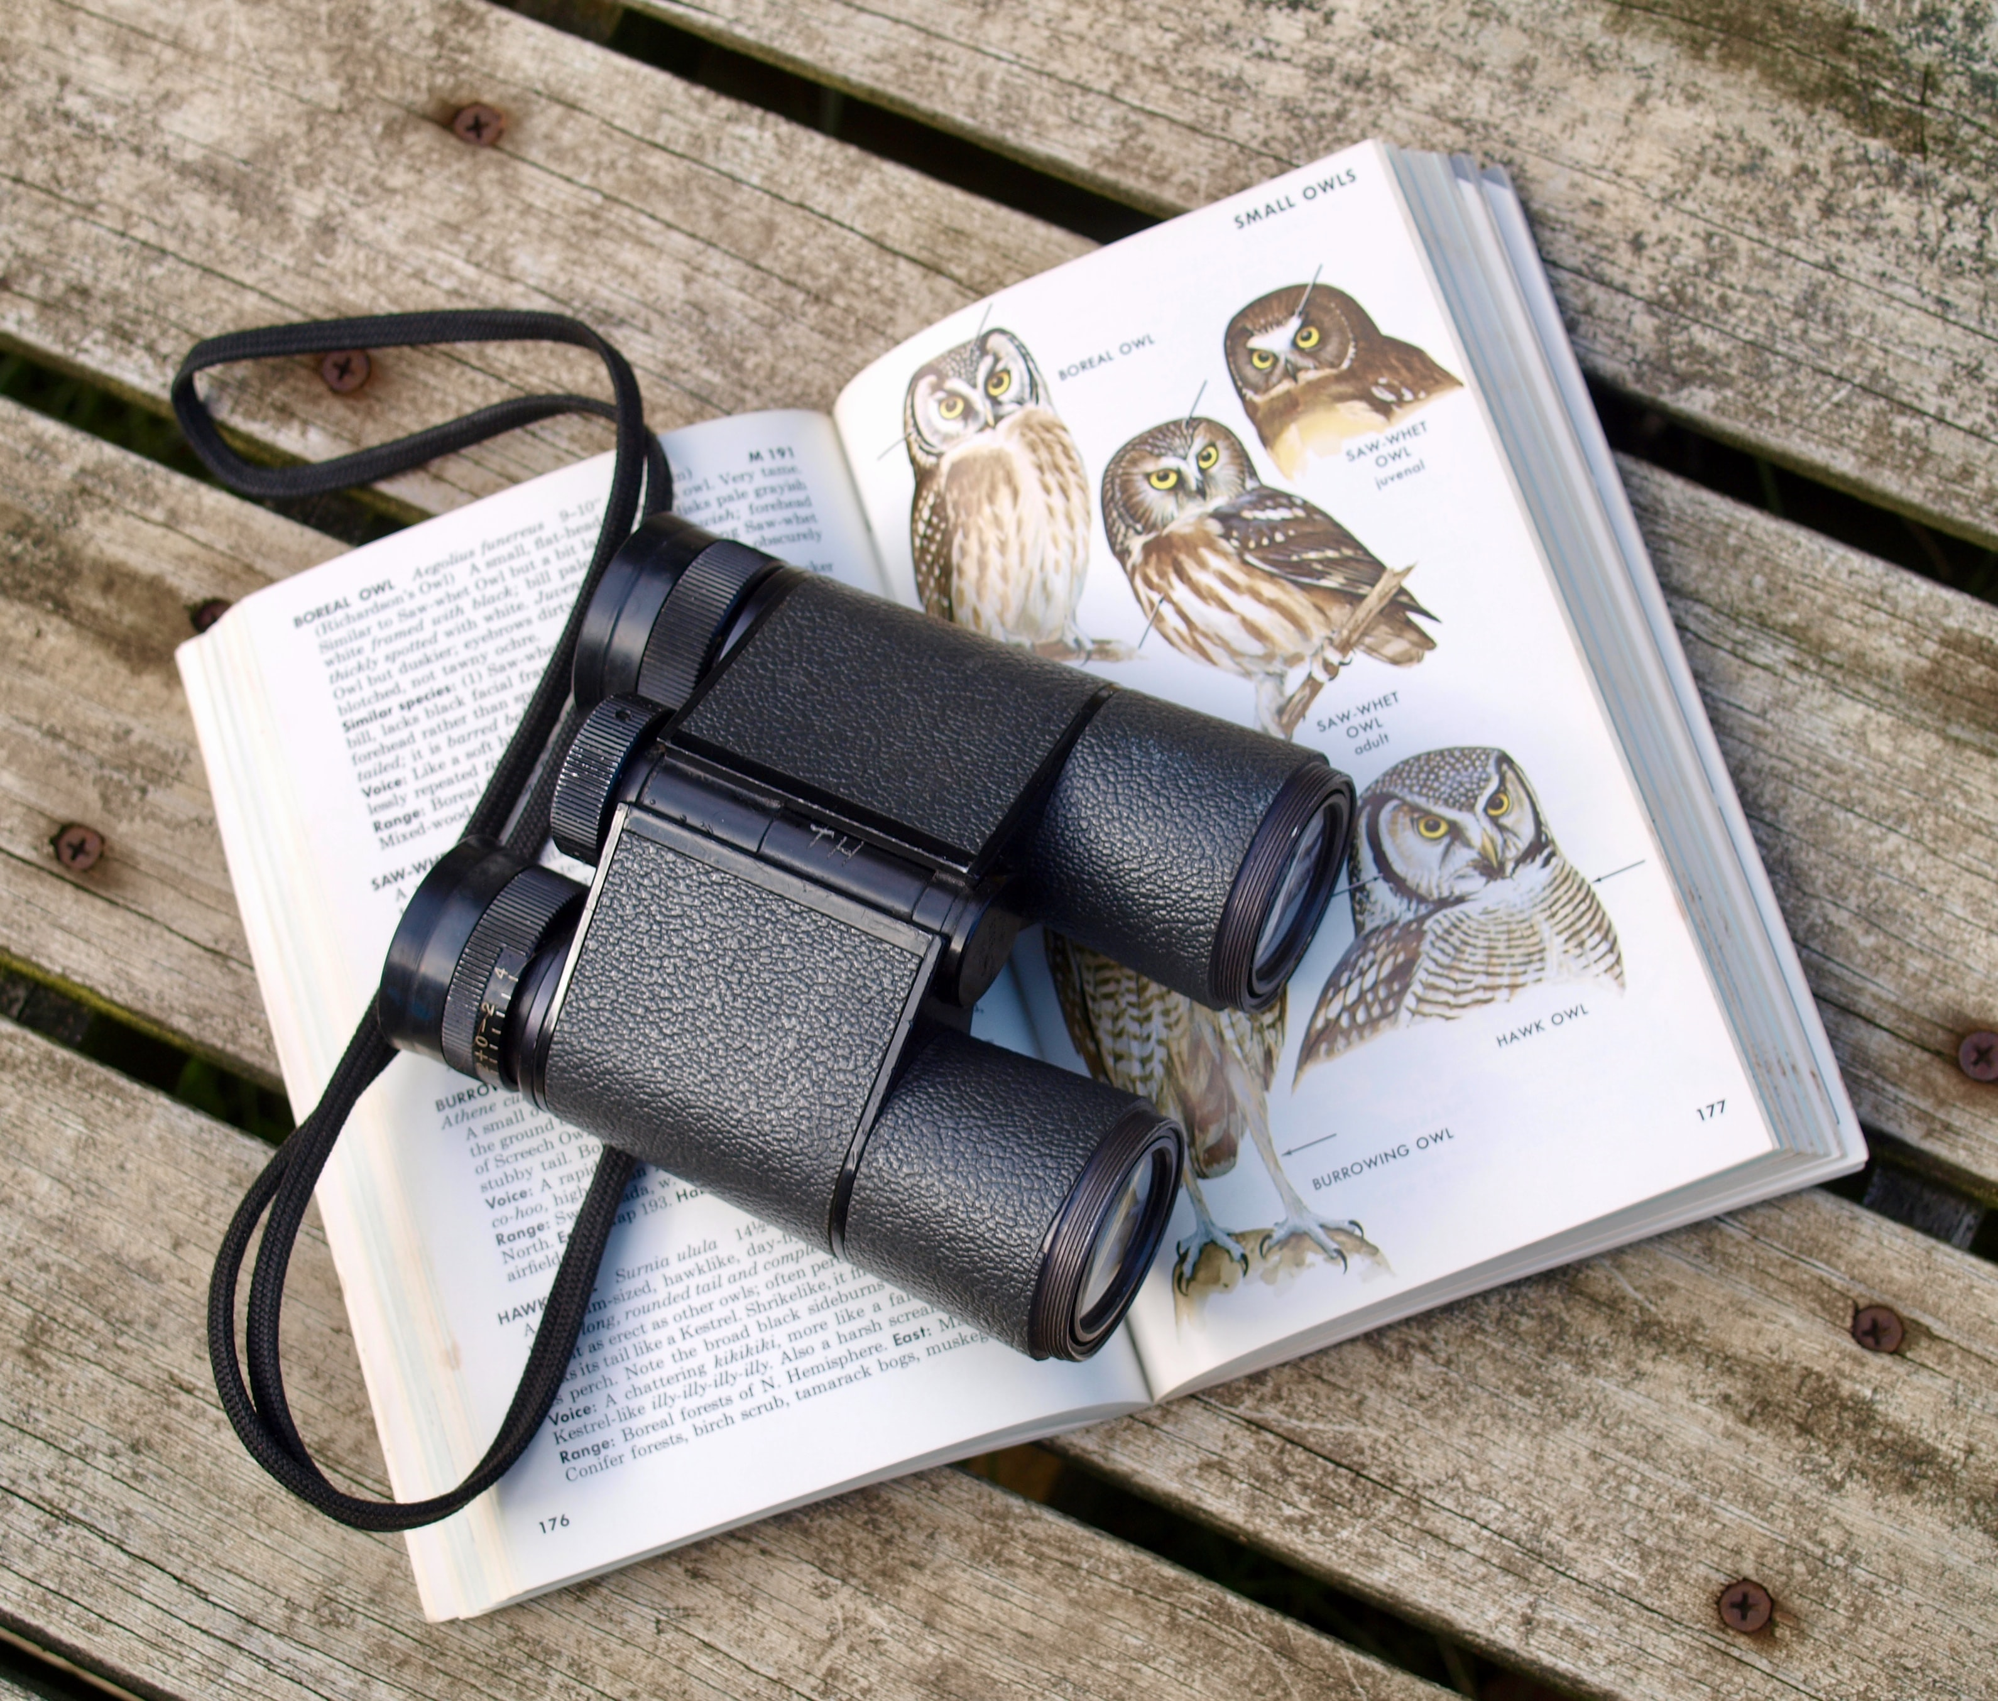
Literature Review
Sensors and cameras to gather data to build deep CNNs that identify, count, and describe the behaviors of different species
Cornell University used supervised learning to predict sightings and migrations of certain bird species.

Slide 3
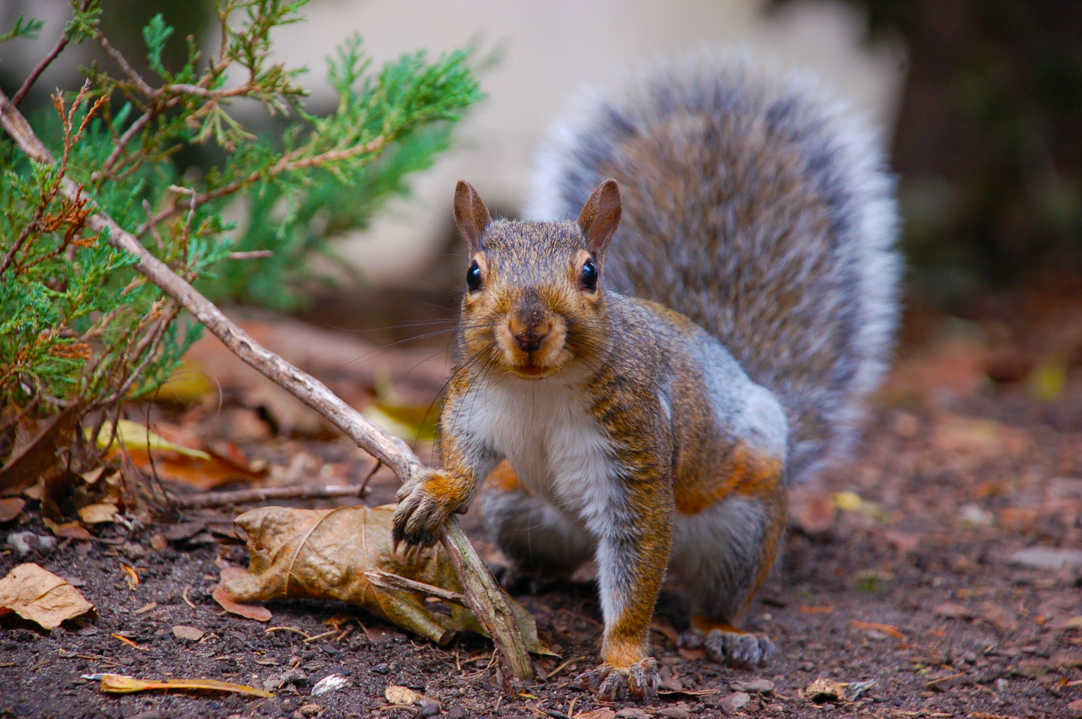
Dataset
Central Park Squirrel Census Data: collected by 323 volunteers on October 2018
3000 observations recorded (2968 used)
Contains information:
data related to space and time
squirrel colors and activities
Amount of data
Reliability of the data
Imbalanced classification

Slide 4
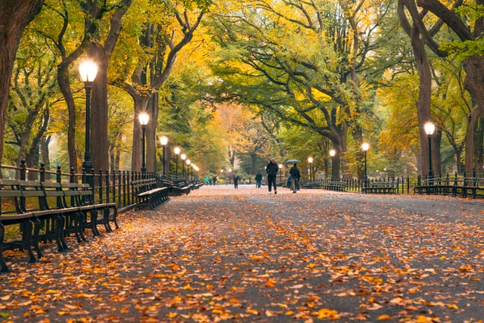
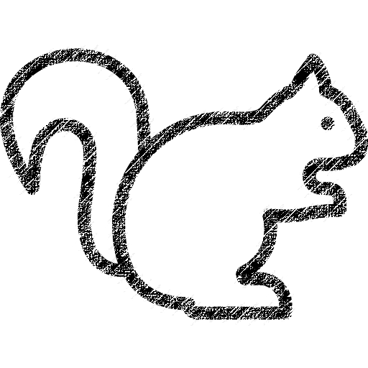
The Goal of the Project
??
??
Multiclass Logistic Regression ?
Multilayer Perceptron ?
Support Vector Machine ?
Decision Tree ?
Random Forest ?
Black?
Location
Time of Day
Date
Gray?
Cinnamon?
White?

Slide 5
The Results
 | Classification Accuracy (%)
Model | Predicting Primary Color | Predicting Highlight Color
Multiclass Logistic Regression | 82.07547 | 34.23181
Multilayer Perceptron | 82.07547 | 34.23181
Support Vector Machine | 82.07547 | 34.90566
Decision Tree | 75.33693 | 44.47439
Random Forest | 82.07547 | 34.90566

Slide 6
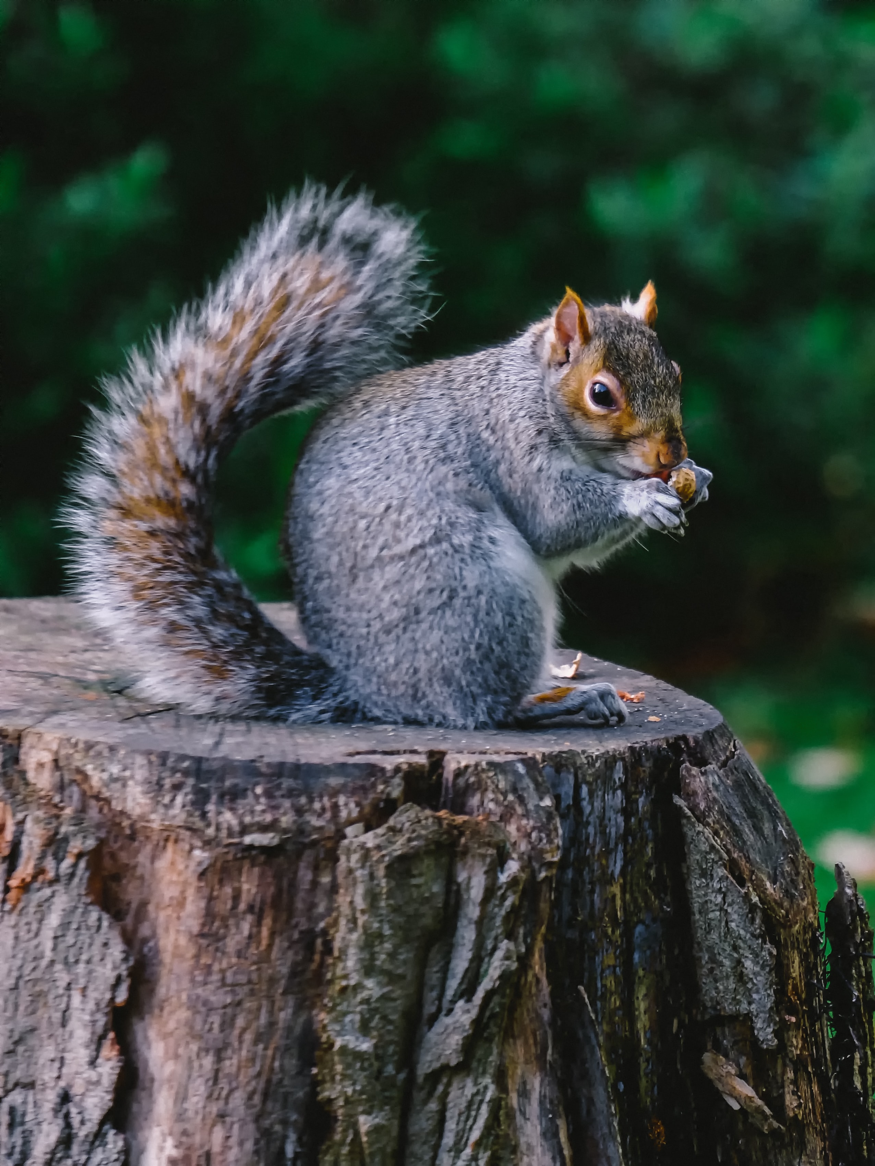
Predicting Primary Color Imbalance Classes Problem
Most of the models only predicted gray squirrels
Gray: 83.32%
Black: 3.47%
Cinnamon: 13.21%
Attempts to solve the problem:
Penalized-SVM: accuracy of 38.14016%
Tree-based algorithms
Random forest with 21 trees: 81.13208%

Slide 7
Predicting Highlight Color
Same initial models were applied:
none achieved classification accuracy > 50%
Highest was decision tree: 44.47439%
Random forests with different number of trees:
The one with 16 trees: 48.51752%
Random forest to predict both primary and highlight colors:
Primary color: 18 trees (80.99730%)
Highlight color: 16 trees (46.76550%)
Both: 16 trees (46.76550%)

Slide 8
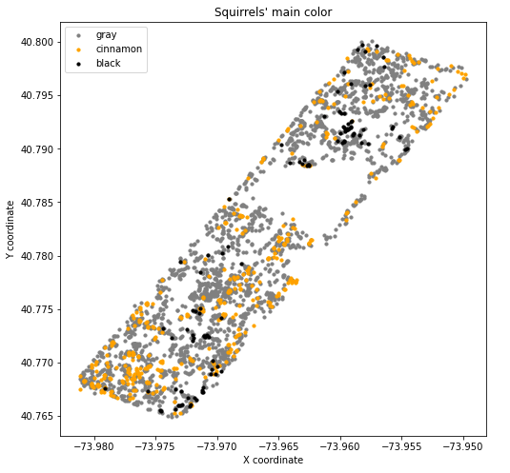
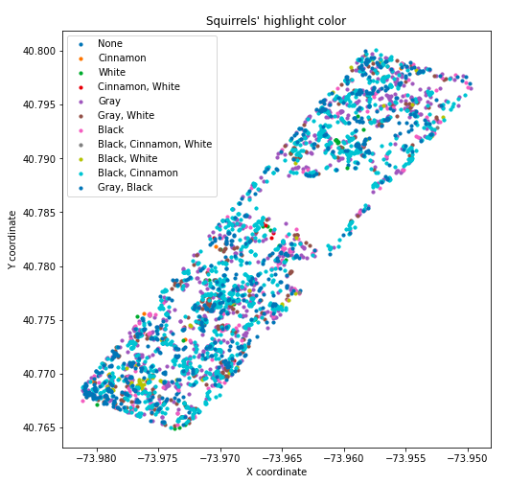
Conclusion
Best performing models: Random forest
Primary fur color: 21 trees
Highlight fur color: 16 trees
Consider other models for highlight fur color (neural network,
KNN?)

Slide 9
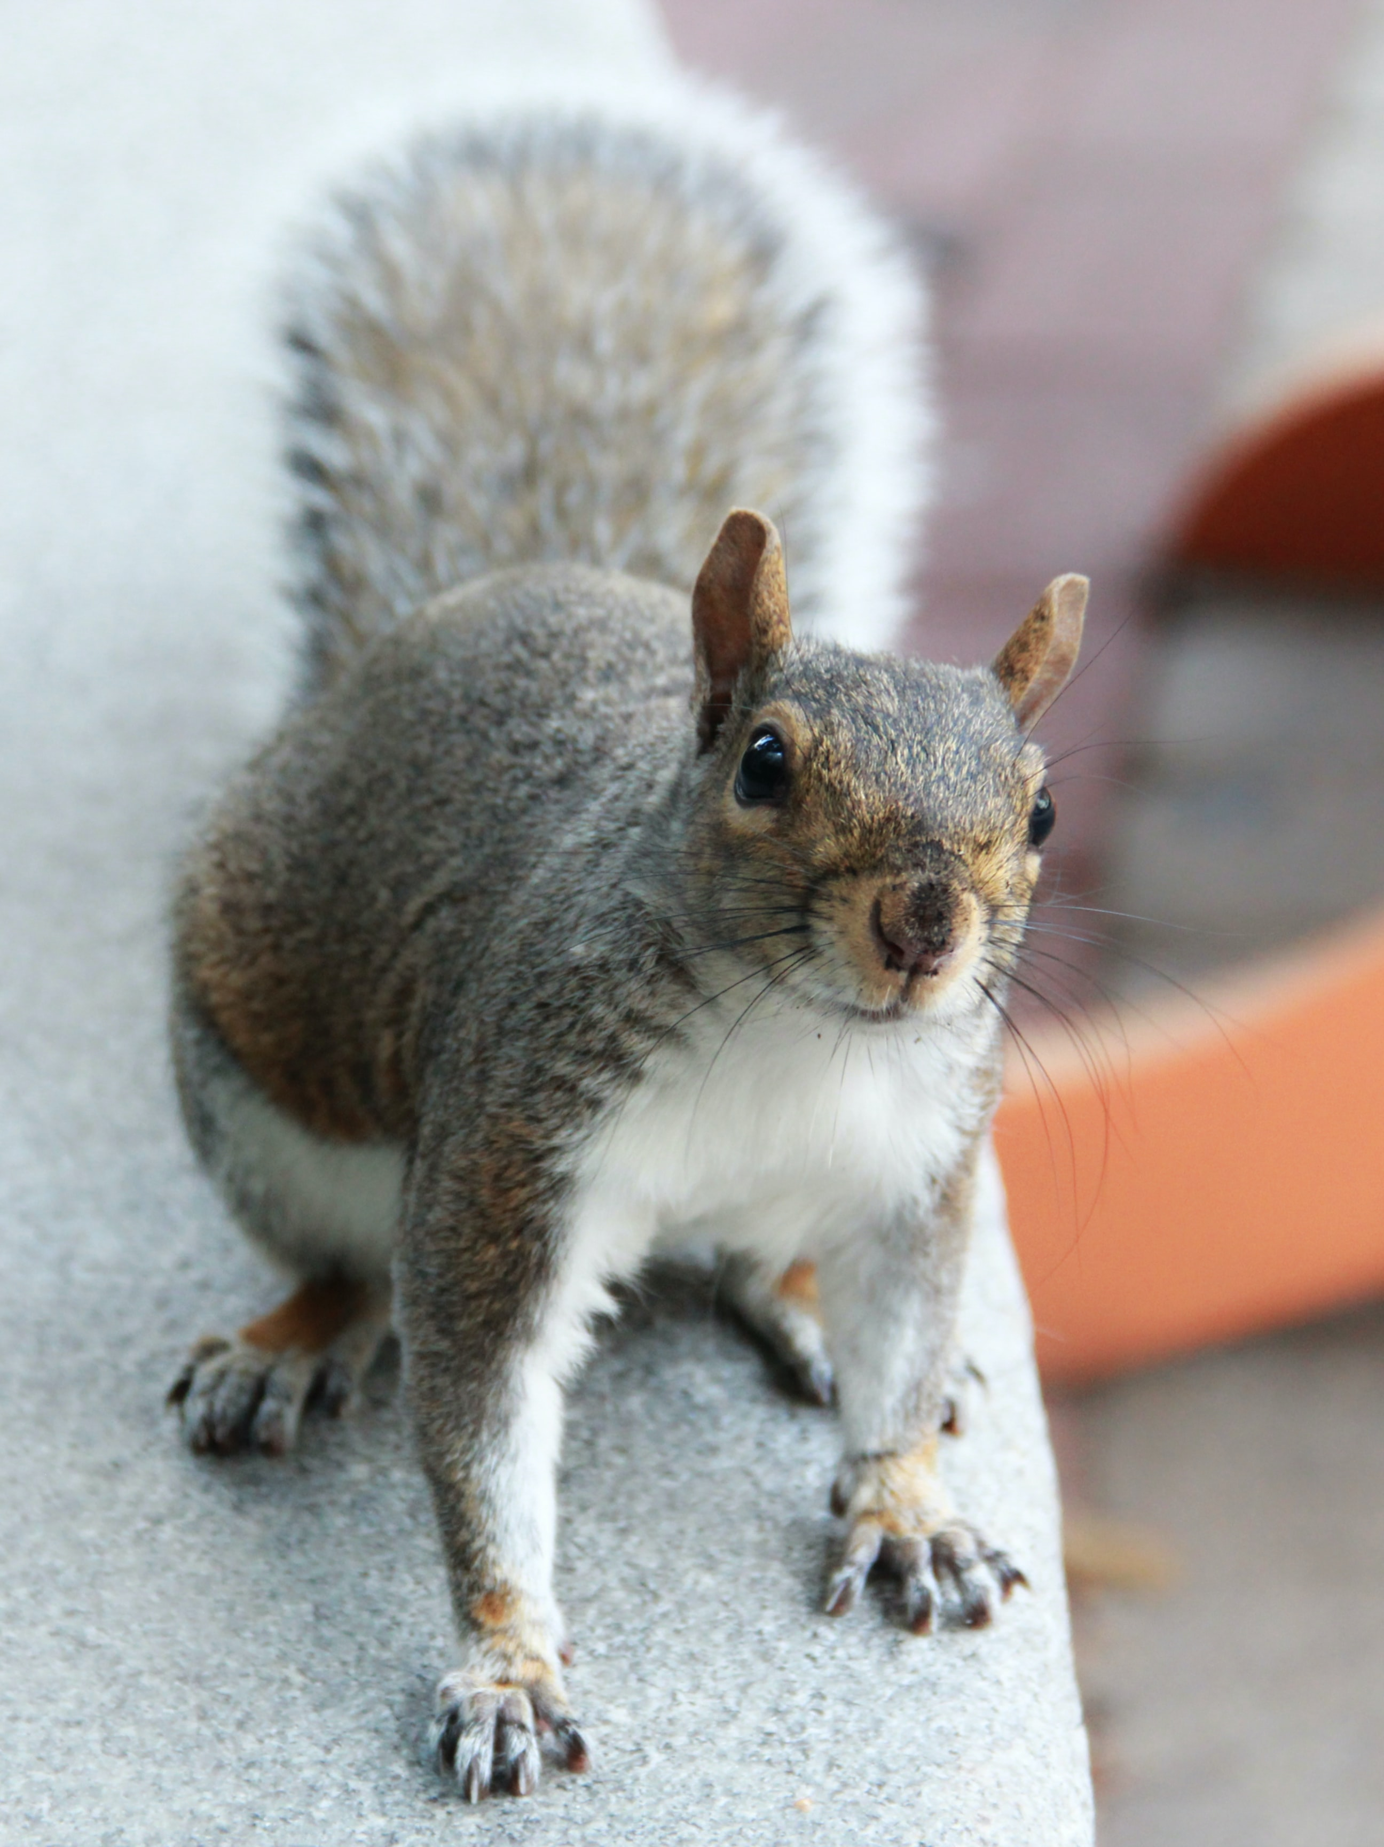
Thank you

